Slide 1

Solubility prediction using machine leaning.

Slide 2
Poor aqueous solubility accounts for a massive percentage of early-stage failures in pharmaceutical development.
Laboratory bench measurements of log(s)require physical compounds, high-purity solvents, and days of experimental execution.
Why Solubility Matters?

Slide 3
Visualizing the data

Slide 4
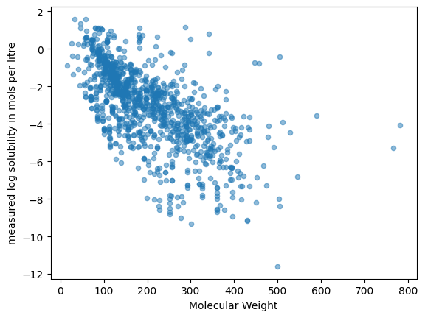

Slide 5
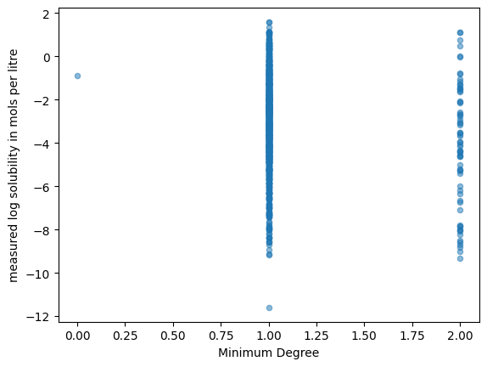

Slide 6
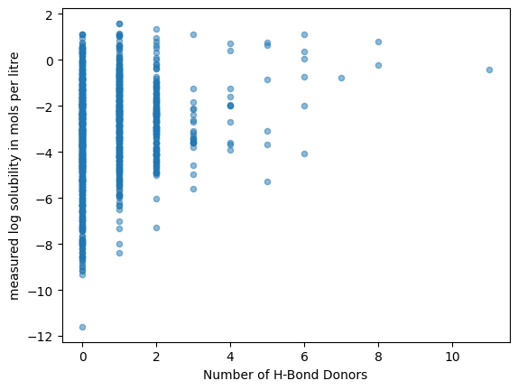

Slide 7
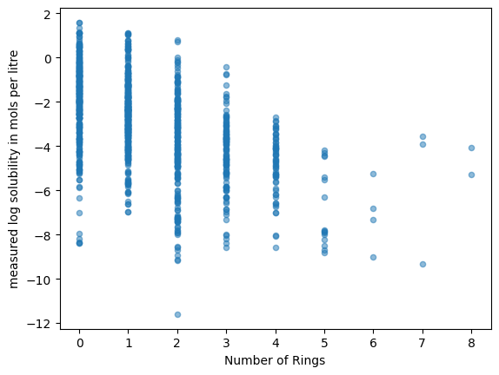

Slide 8
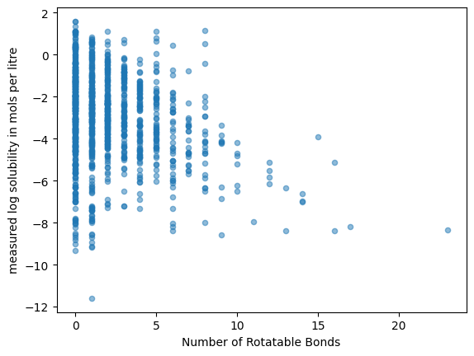

Slide 9
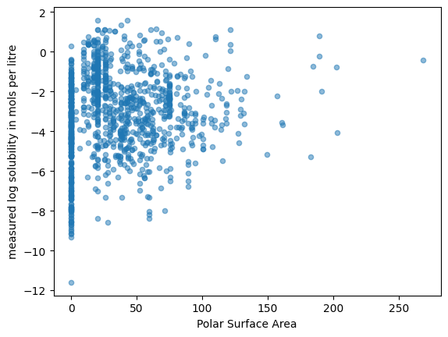

Slide 10
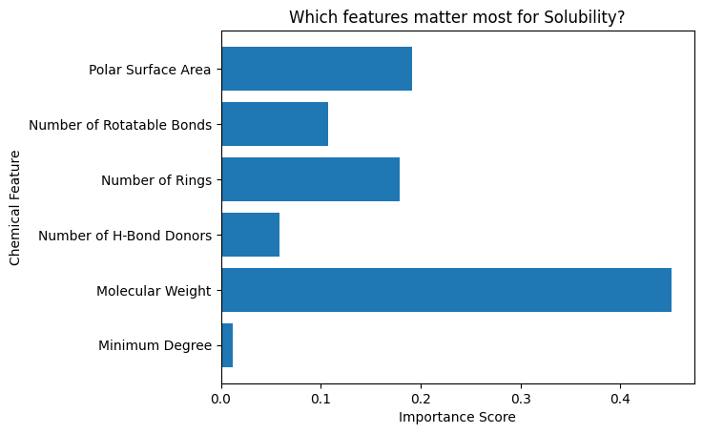

Slide 11
Comparing model
MODEL | Cross Validation Scores MEAN | STANDARD DEVIATION
Linear Regression | 1.18 | 0.09
Decision Tree | 1.12 | 0.14
Random Forest | 0.86 | 0.12

Slide 12

THANK YOU
Vansh Patwa
School of Chemical Sciences, NISER Bhubaneswar
https://github.com/VanshPatwa/ML---Chemistry-Project

